Slide 1
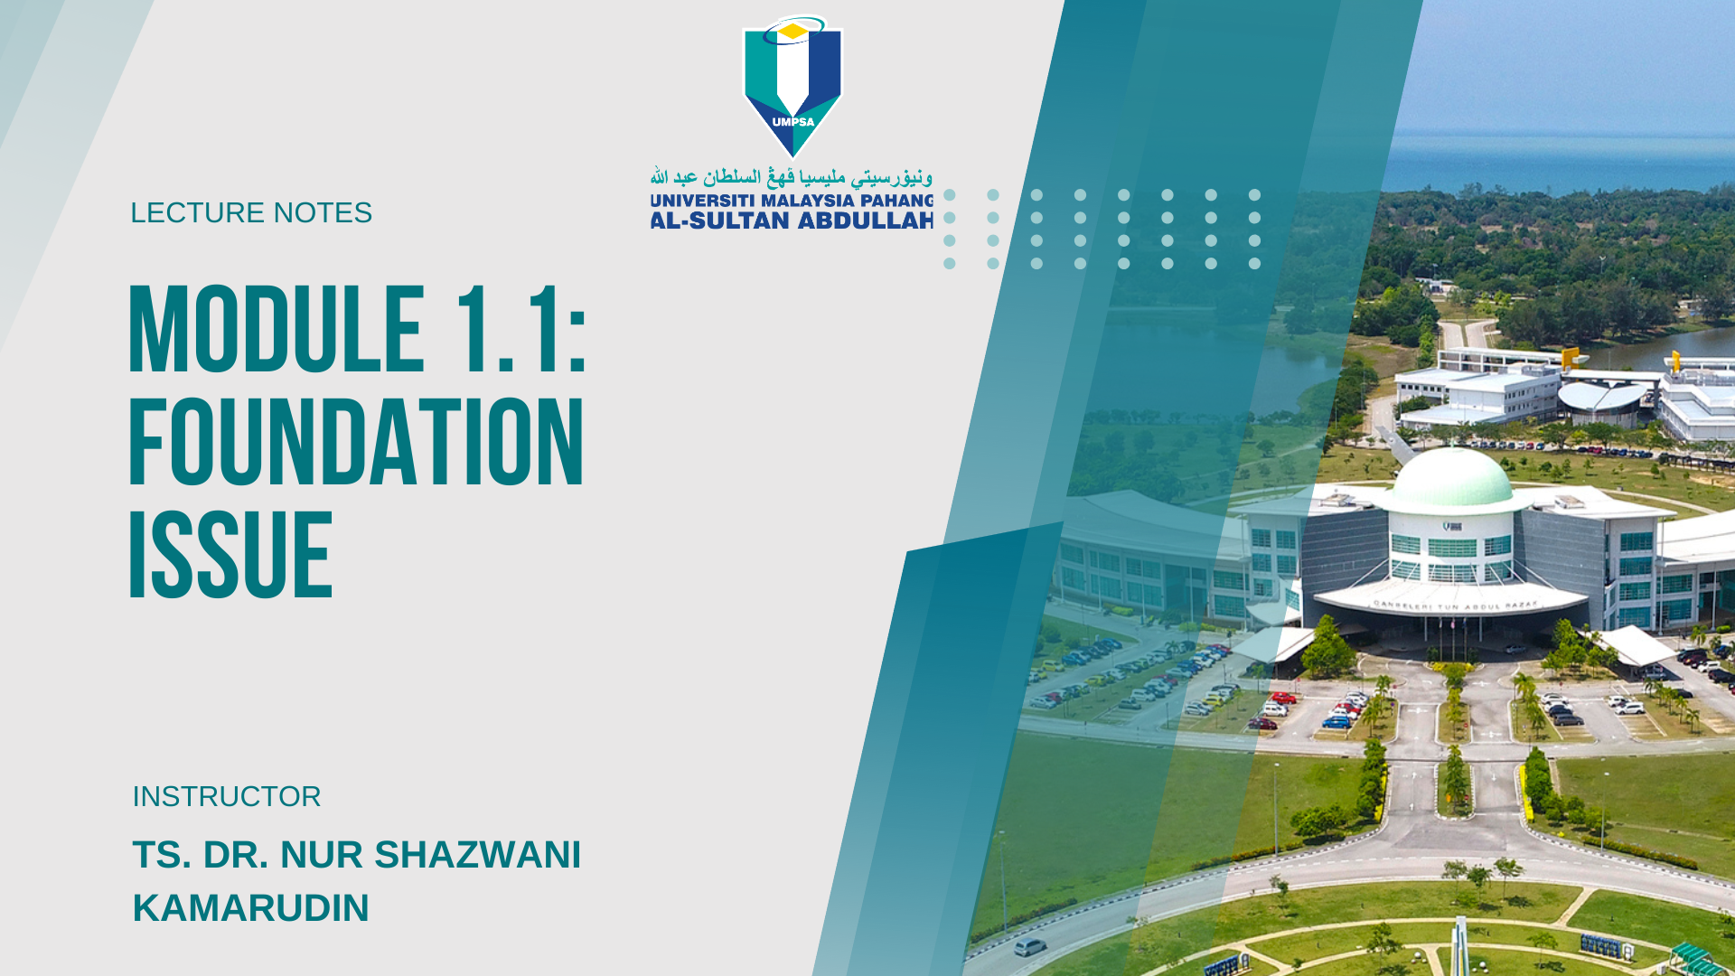

Slide 2

Learning Objectives
What is AI?
The History of AI
AI Examples
Conclusion

Slide 3
What is AI?

Slide 4
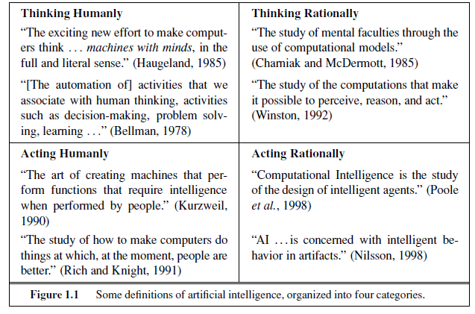
What is AI?
Source: Russell and Norvig, “Artificial Intelligence: A Modern Approach”. 3rd Edition

Slide 5
Acting humanly: The Turing Test approach
Proposed by Alan Turing (1950)- to provide a satisfactory operational definition of intelligence
A computer passes the test if a human interrogator, after posing some written questions, cannot tell whether the written responses come from a person or from a computer.
The computer would need to possess the following capabilities:
natural language processing to enable it to communicate successfully in English
knowledge representation to store what it knows or hears
automated reasoning to use the stored information to answer questions and to draw new conclusions
machine learning to adapt to new circumstances and to detect and extrapolate patterns
Turing’s test deliberately avoided direct physical interaction between the interrogator and the computer, because physical simulation of a person is unnecessary for intelligence.
However, the so-called total Turing Test includes a video signal so that the interrogator can test the subject’s perceptual abilities, as well as the opportunity for the interrogator to pass physical objects “through the hatch.”
To pass the total Turing Test, the computer will need:
computer vision to perceive objects
robotics to manipulate objects and move about

Slide 6
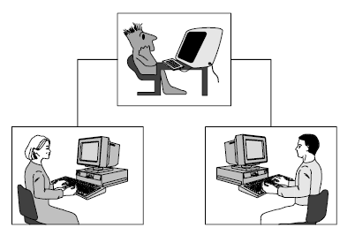
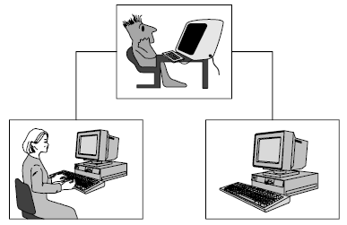
Eg: Turing Imitation Game- Phase 1 & Phase 2
Figure 1.1 Turing imitation game: phase 1
Figure 1.2 Turing imitation game: phase 2
The interrogator, a man and a woman are each placed in separate rooms and can communicate only via a neutral medium such as a remote terminal. The interrogator’s objective is to work out who is the man and who is the woman by questioning them. The rules of the game are that the man should attempt to deceive the interrogator that he is the woman, while the woman has to convince the interrogator that she is the woman.
The man is replaced by a computer programmed to deceive the interrogator as the man did. It would even be programmed to make mistakes and provide fuzzy answers in the way a human would. If the computer can fool the interrogator as often as the man did, we may say this computer has passed the intelligent behaviour test.
Source: Michael Negnevitsky. “Artificial Intelligence: A Guide to Intelligent Systems”. 2nd Edition

Slide 7
Turing Imitation Game: Phase 1 & Phase 2 (Conti..)
Physical simulation of a human is not important for intelligence. Hence, in the Turing test the interrogator does not see, touch or hear the computer and is therefore not influenced by its appearance or voice.
However, the interrogator is allowed to ask any questions, even provocative ones, in order to identify the machine. The interrogator may, for example, ask both the human and the machine to perform complex mathematical calculations, expecting that the computer will provide a correct solution and will do it faster than the human.
Thus, the computer will need to know when to make a mistake and when to delay its answer. The interrogator also may attempt to discover the emotional nature of the human, and thus, he might ask both subjects to examine a short novel or poem or even painting. Obviously, the computer will be required here to simulate a human’s emotional understanding of the work.

Slide 8
Turing Imitation Game: Phase 1 & Phase 2 (Conti..)
The Turing test has two remarkable qualities that make it really universal.
By maintaining communication between the human and the machine via terminals, the test gives us an objective standard view on intelligence. It avoids debates over the human nature of intelligence and eliminates any bias in favour of humans.
The test itself is quite independent from the details of the experiment. It can be conducted either as a two-phase game as just described, or even as a single phase game in which the interrogator needs to choose between the human and the machine from the beginning of the test. The interrogator is also free to ask any question in any field and can concentrate solely on the content of the answers provided.

Slide 9
Thinking humanly: The cognitive modeling approach
If we are going to say that a given program thinks like a human, we must have some way of determining how humans think.
We need to get inside the actual workings of human minds.
Three ways to do this:
through introspection- trying to catch our own thoughts as they go by;
through psychological experiments- observing a person in action;
Through brain imaging- observing the brain in action.
If the program’s input–output behaviour matches corresponding human behaviour, that is evidence that some of the program’s mechanisms could also be operating in humans.
The interdisciplinary field of cognitive science brings together computer models from AI and experimental techniques from psychology to construct precise and testable theories of the human mind
In the early days of AI there was often confusion between the approaches: an author would argue that an algorithm performs well on a task and that it is therefore a good model of human performance, or vice versa.
Modern authors separate the two kinds of claims; this distinction has allowed both AI and cognitive science to develop more rapidly.
The two fields continue to fertilize each other, most notably in computer vision, which incorporates neurophysiological evidence into computational models.

Slide 10
Thinking rationally: The “laws of thought” approach
The Greek philosopher Aristotle was one of the first to attempt to codify “right thinking,” that is, irrefutable reasoning processes.
His syllogisms provided patterns for argument structures that always yielded correct conclusions when given correct premises—for example, “Socrates is a man; all men are mortal; therefore, Socrates is mortal.”
These laws of thought were supposed to govern the operation of the mind; their study initiated the field called logic.
There are two main obstacles to this approach:
it is not easy to take informal knowledge and state it in the formal terms required by logical notation, particularly when the knowledge is less than 100% certain.
there is a big difference between solving a problem “in principle” and solving it in practice.
Even problems with just a few hundred facts can exhaust the computational resources of any computer unless it has some guidance as to which reasoning steps to try first.
Although both of these obstacles apply to any attempt to build computational reasoning systems, they appeared first in the logicist tradition (to create intelligent systems).

Slide 11
Acting rationally: The rational agent approach
An agent is just something that acts (agent comes from the Latin agere, to do)
A rational agent is one that acts so as to achieve the best outcome or, when there is uncertainty, the best expected outcome.
In the “laws of thought” approach to AI, the emphasis was on correct inferences. Making correct inferences is sometimes part of being a rational agent, because one way to act rationally is to reason logically to the conclusion that a given action will achieve one’s goals and then to act on that conclusion.
On the other hand, correct inference is not all of rationality; in some situations, there is no provably correct thing to do, but something must still be done.
All the skills needed for the Turing Test also allow an agent to act rationally. Knowledge representation and reasoning enable agents to reach good decisions.
The rational-agent approach has two advantages over the other approaches:
It is more general than the “laws of thought” approach because correct inference is just one of several possible mechanisms for achieving rationality.
it is more amenable to scientific development than are approaches based on human behaviour or human thought.

Slide 12
The history of AI

Slide 13
The History of AI
The beginning of AI (1943 - 1956):
1943: McCulloch & Pitts: Boolean circuit model of brain.
1950: Turing’s “Computing Machinery and Intelligence”.
1956: John McCarthy coined the term "artificial intelligence" as the topic of the Dartmouth Conference, the first conference devoted to the subject.
Rise of AI, era of great expectations (1956 - 1960):
Early successful AI programs: Samuel’s checkers,
Newell & Simon’s Logic Theorist, Gelernter’s Geometry
Theorem Prover.
Robinson’s complete algorithm for logical reasoning.

Slide 14
The History of AI
A dose of reality (1966 - 1974):
AI discovered computational complexity.
Neural network research almost disappeared after
Minsky & Papert’s book in 1969.
Knowledge-based systems (1969 - 1979):
1969: DENDRAL by Buchanan et al..
1976: MYCIN by Shortliffle.
1979: PROSPECTOR by Duda et al..

Slide 15
The History of AI
AI becomes an industry (1980 - 1988):
Expert systems industry booms.
1981: Japan’s 10-year Fifth Generation project.
The return of NNs and novel AI (1986 - present):
Mid 80’s: Back-propagation learning algorithm reinvented.
Expert systems industry busts.
1988: Resurgence of probability.
1988: Novel AI (ALife, GAs, Soft Computing, …).
1995: Agents everywhere.
2003: Human-level AI back on the agenda.

Slide 16
AI Examples

Slide 17
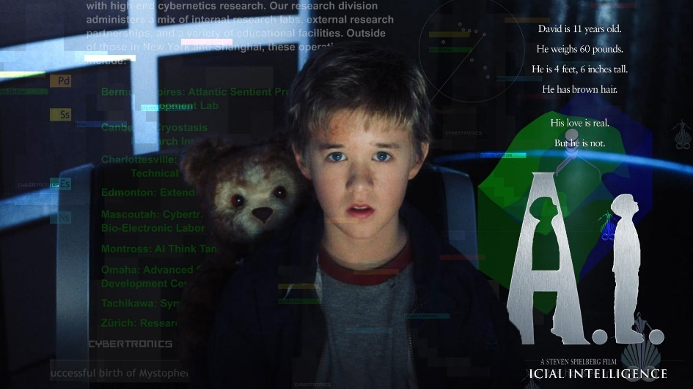
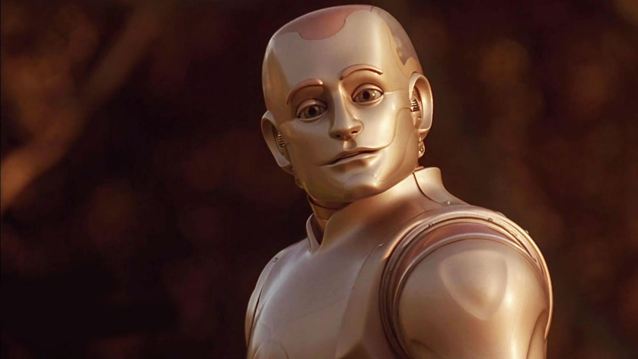
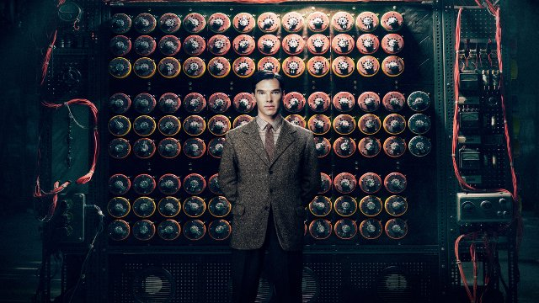
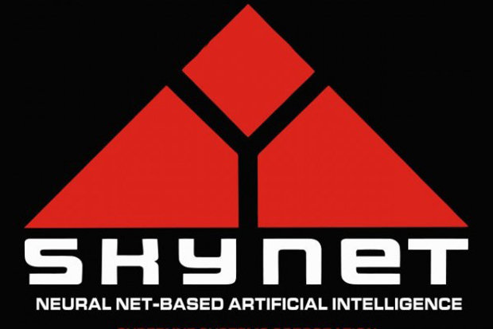

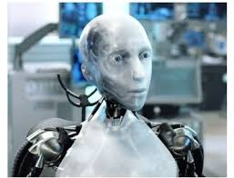
AI Example

Slide 18

SimSimi

Slide 19
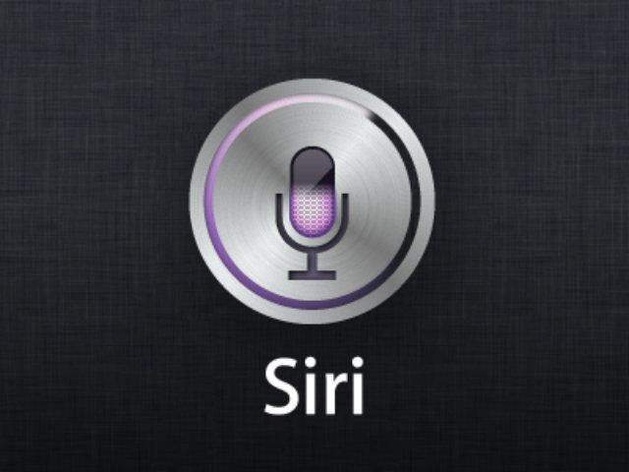
Apple Siri

Slide 20

Amazon Alexa

Slide 21
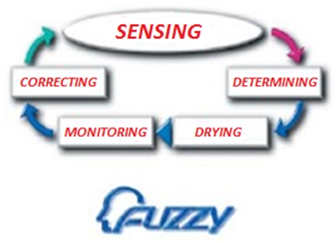
Washing Machine

Slide 22
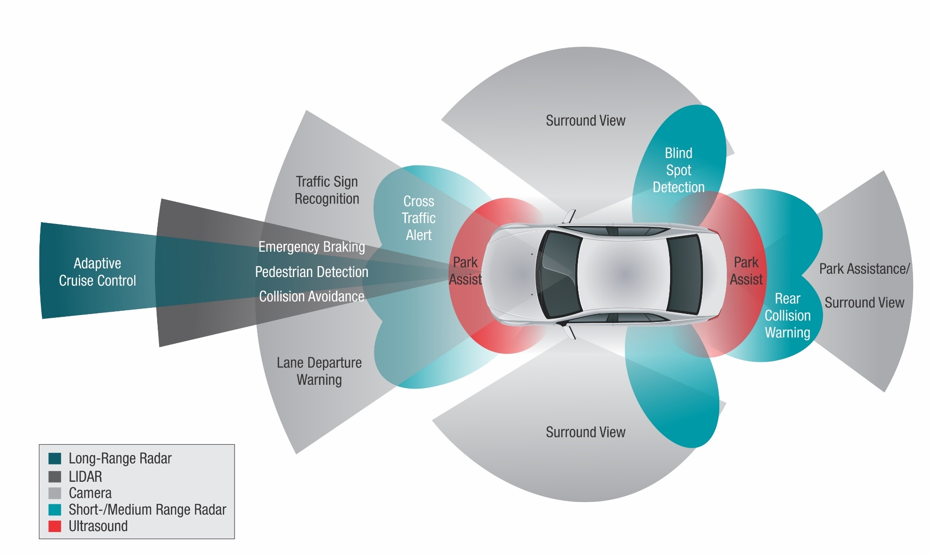
Smart Car

Slide 23
Conclusion
AI has a dual role:
1) to study human intelligence
2) to study machine intelligence

